Slide 1





Privacy is everywhere.
Government, company, research centers collect personal information and analyze them.
Social networks: Facebook, LinkedIn
YouTube & Amazon use viewing/buying records for recommendations.

Slide 2
Privacy is everywhere.
Government, company, research centers collect personal information and analyze them.
Social networks: Facebook, LinkedIn
YouTube & Amazon use viewing/buying records for recommendations.

Slide 3
Privacy is everywhere.
Government, company, research centers collect personal information and analyze them.
Social networks: Facebook, LinkedIn
YouTube & Amazon use viewing/buying records for recommendations.

Slide 4
Sometimes, we expose our information without even noticing that

Slide 5
Let’s first look at a dataset:
(Example 1.1)
Customer ID | Rating | Date
1488844 | 3 | 2005-09-06
822109 | 5 | 2005-05-13
885013 | 4 | 2005-10-19
30878 | 4 | 2005-12-26
823519 | 3 | 2004-05-03

Slide 6
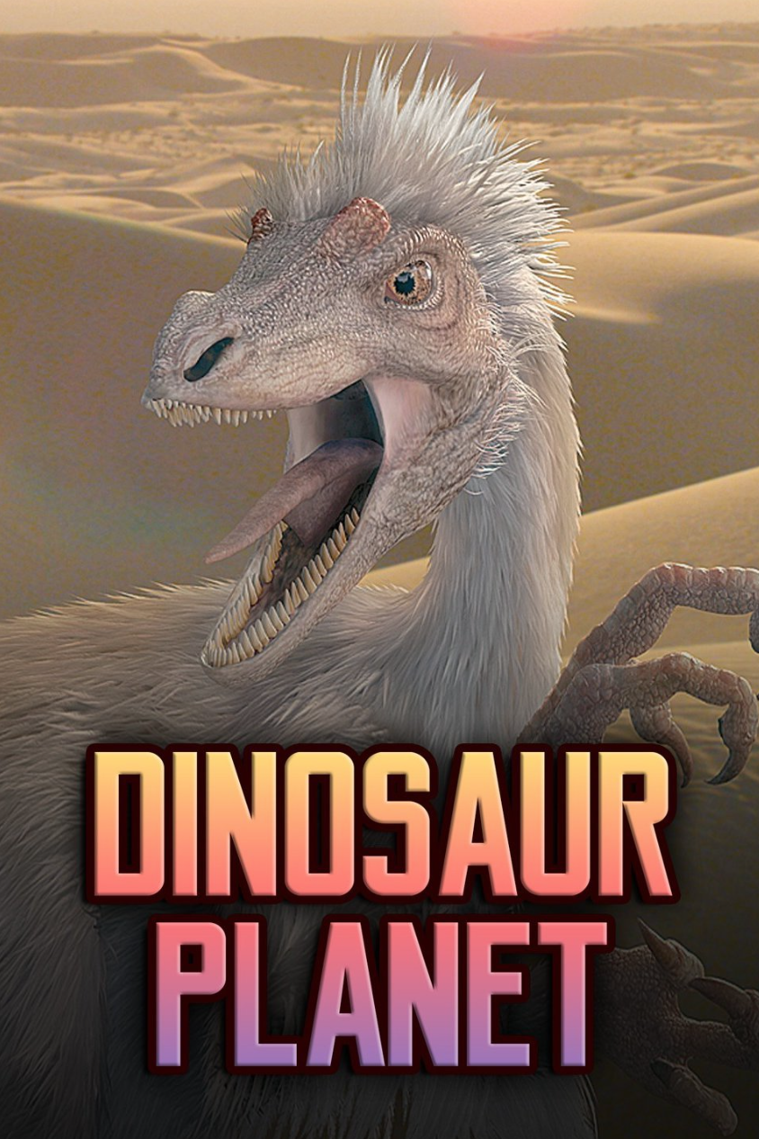
This is the first five rows of the rating of movie “dinosaur planet” from Netflix Prize dataset,
Customer ID | Rating | Date
1488844 | 3 | 2005-09-06
822109 | 5 | 2005-05-13
885013 | 4 | 2005-10-19
30878 | 4 | 2005-12-26
823519 | 3 | 2004-05-03
. . . | . . . | . . .
Netflix Prize dataset:
Netflix released a dataset containing 100,480,507 Movie Ratings and Their Dates created by 480,189 Netflix subscribers. In 2006, Netflix organized an algorithm competition using this data to predict movie ratings. But this competition quitted in 2010 due to the privacy problem and they payed a large amount of fines

Slide 7


Do you feel safe enough (your privacy is preserved) if your data is in this dataset?
YES!
NO!

Slide 8
This dataset is anonymous and only shows custom ID, movie rating and rating date. It seems safe enough and no one can infer your information.
But congrats/unfortunately, you’re RIGHT/WRONG!

Slide 9
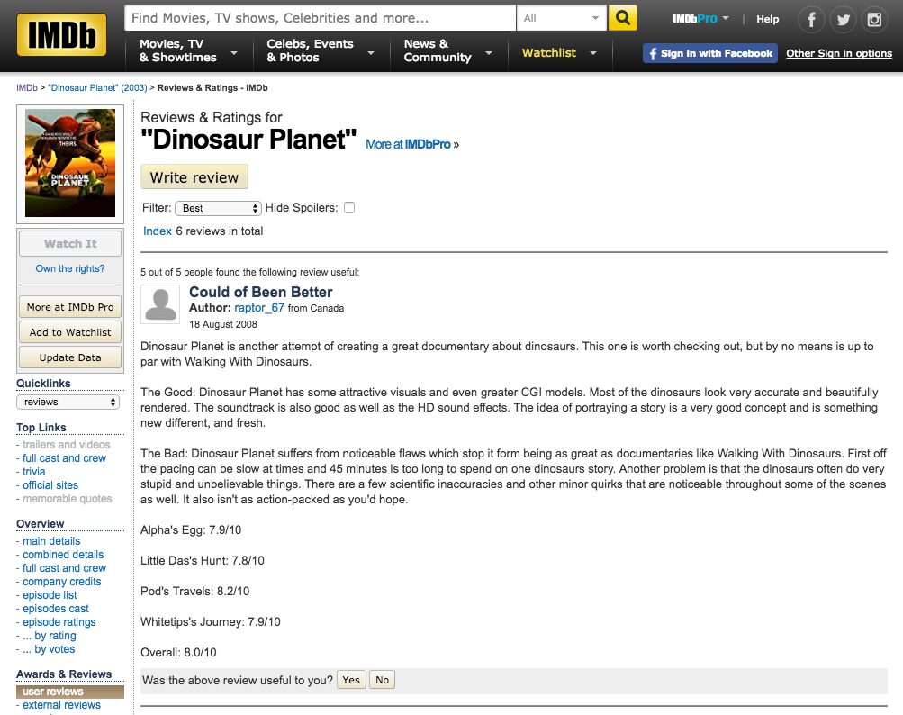

Using the Internet Movie Database (IMDb) as the source of background knowledge,
Reviews&Rating in IMDb has similar rating, rating date or movies one watched with in Netflix data
A. Narayanan and V. Shmatikov successfully identified the Netflix records of known users, uncovering their apparent political preferences and other potentially sensitive information.

Slide 10

Anonymity does NOT mean privacy, since auxiliary information can help adversary to break anonymity.
* Dwork C. (2006) Differential Privacy. In: Bugliesi M., Preneel B., Sassone V., Wegener I. (eds) Automata, Languages and Programming. ICALP 2006. Lecture Notes in Computer Science, vol 4052. Springer, Berlin, Heidelberg

Slide 11
Anonymity does NOT mean privacy, since auxiliary information can help adversary to break anonymity.
The key is how to mask the property of any individuals.
* Dwork C. (2006) Differential Privacy. In: Bugliesi M., Preneel B., Sassone V., Wegener I. (eds) Automata, Languages and Programming. ICALP 2006. Lecture Notes in Computer Science, vol 4052. Springer, Berlin, Heidelberg

Slide 12

Let’s take a look at another example!
(Example 1.2)

Slide 13
Considering the following sample patient dataset, denoted D1, which includes patient’s name, age and if he/she has HIV.
Name | Age | HIV
Alice | 20 | N
Bob | 25 | N
Tom | 38 | Y
Jane | 16 | Y
Jason | 31 | N
Dataset D1

Slide 14


Assume a hacker knows Alice is in the first row of this dataset. He wants to know if Alice has HIV or not. He then submits queries to collect information from dataset D1.
YOU
Dataset D1
Name | Age | HIV
Alice | 20 | Y
Bob | 25 | N
Tom | 38 | Y
Jane | 16 | Y
Jason | 31 | N

Slide 15
First, he tried a query: how many people have HIV?
YOU
Dataset D1
Name | Age | HIV
Alice | 20 | Y
Bob | 25 | N
Tom | 38 | Y
Jane | 16 | Y
Jason | 31 | N
QUERY

Slide 16
You can first try a query: how many people have HIV?
How many people have HIV?
YOU
Dataset D1
Name | Age | HIV
Alice | 20 | Y
Bob | 25 | N
Tom | 38 | Y
Jane | 16 | Y
Jason | 31 | N
QUERY

Slide 17
The answer is 3.
How many people have HIV
YOU
Dataset D1
Name | Age | HIV
Alice | 20 | Y
Bob | 25 | N
Tom | 38 | Y
Jane | 16 | Y
Jason | 31 | N
Answer: 3
QUERY

Slide 18
Since he knows Alice is in the first row, he DELETE her data
How many people have HIV
YOU
Dataset D1
Name | Age | HIV
Alice | 20 | Y
Bob | 25 | N
Tom | 38 | Y
Jane | 16 | Y
Jason | 31 | N
Answer: 3
Alice
DELETE

Slide 19

Then, you get a dataset D2 differing one single row from dataset D1.
Now, if you perform the same query on D2.
How many people have HIV
YOU
Dataset D2
Dataset D1
Name | Age | HIV
Bob | 25 | N
Tom | 38 | Y
Jane | 16 | Y
Jason | 31 | N
Answer: 3
QUERY

Slide 20
You got answer 2. Then you will know Alice has HIV
How many people have HIV
How many people have HIV
YOU
Dataset D2
Dataset D1
Name | Age | HIV
Bob | 25 | N
Tom | 38 | Y
Jane | 16 | Y
Jason | 31 | N
Answer: 3
QUERY
Answer: 2

Slide 21

How do we mask such information disclosure caused by the addition or removal of one single row in the database?

Slide 22
Let’s first learn a concept --- neighboring databases/datasets: differing by addition or removal of one single row

Slide 23

Let’s first learn a concept --- neighboring databases/datasets: differing by addition or removal of a single row
Name | Age | HIV
Alice | 20 | N
Bob | 25 | N
Tom | 38 | Y
Jane | 16 | Y
Jason | 31 | N
Name | Age | HIV
Alice | 20 | Y
Bob | 25 | N
Tom | 38 | Y
Jane | 16 | N
Jason | 31 | Y
Name | Age | HIV
Bob | 25 | N
Tom | 38 | Y
Jane | 16 | Y
Jason | 31 | N
Adding or removing one single row
Database D1
Database D2
D1, D2 are neighboring databases/datasets

Slide 24
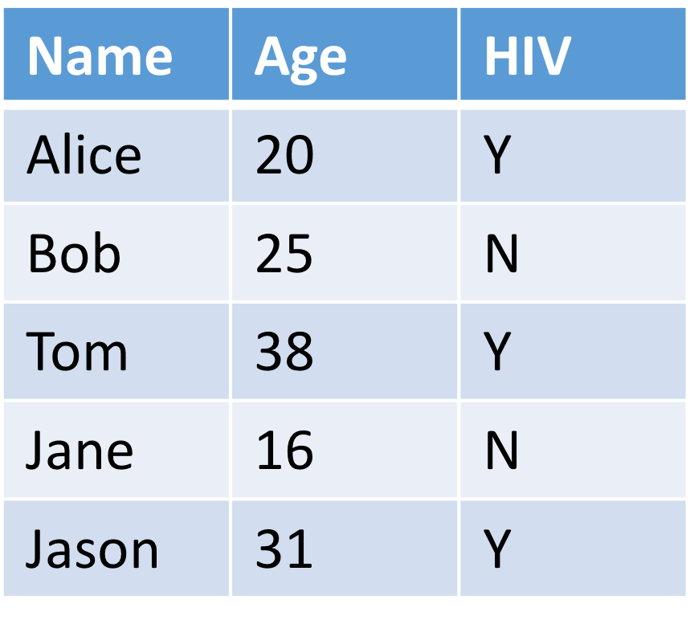
These datasets are also possible neighboring datasets of D1,
since they all differ in one row as compared to D1
Name | Age | HIV
Alice | 20 | Y
Bob | 25 | N
Tom | 38 | Y
Jane | 16 | N
Jason | 31 | Y
Name | Age | HIV
Alice | 20 | N
Bob | 25 | N
Tom | 38 | Y
Jane | 16 | Y
Jason | 31 | N
neighboring datasets
or
Name | Age | HIV
Alice | 20 | Y
Bob | 25 | N
Tom | 38 | Y
Jane | 16 | N
Jason | 31 | Y
Database D1
or

Slide 25
Differential privacy is designed to MASK DIFFERENCE between the same query to the neighboring datasets.

Slide 26
Differential privacy is trying to MASK DIFFERENCE of the same query to the neighboring datasets
Let’s re-visit the example you just saw!
How do we preserve Alice’s privacy?

Slide 27
Differential privacy is trying to MASK DIFFERENCE of the same query to the neighboring datasets
How many people have HIV
How many people have HIV
ADVERSARY
Dataset D2
Dataset D1
D1 and D2 are neighboring datasets
Answer: 3
Answer: 2

Slide 28
Differential privacy is trying to MASK DIFFERENCE of the same query to the neighboring datasets
How many people have HIV
How many people have HIV
ADVERSARY
Dataset D2
Dataset D1
D1 and D2 are neighboring datasets
Answer: A
Let’s say now we don’t return the true query results
Answer: B

Slide 29

Differential privacy is trying to MASK DIFFERENCE of the same query to the neighboring datasets
How many people have HIV
How many people have HIV
ADVERSARY
Dataset D2
Dataset D1
D1 and D2 are neighboring datasets
Answer: A
$$≈$$
Instead, we return similar results to both queries
Answer: B

Slide 30
Differential privacy is trying to MASK DIFFERENCE of the same query to the neighboring datasets
How many people have HIV
How many people have HIV
ADVERSARY
Dataset D2
Dataset D1
D1 and D2 are neighboring datasets
Answer: A
$$≈$$
This promises that similar information will be learnt no matter if Alice is in the dataset or not
Answer: B

Slide 31

Differential privacy promises individuals that no more additional harm they may face whether their data is IN the dataset or NOT IN

Slide 32
How can we achieve this?

Slide 33

How can we achieve this?
How many people have HIV
How many people have HIV
ADVERSARY
Dataset D2
Dataset D1
Answer: A
$$≈$$
Answer: B
How can we achieve this?

Slide 34

We add a randomized function between true answer and the final response
How many people have HIV
How many people have HIV
ADVERSARY
Dataset D2
Dataset D1
D1 and D2 are neighboring datasets
Answer: 3
Randomized function
Answer: 2
Answer: A
$$≈$$
Answer: B

Slide 35
What is randomized function?
Randomized function
A randomized function here is used to PERTURB the TRUE answer to a query by adding random noise generated by a distribution:
Notes:
Instead of answering the true result 1, the mechanism will give a random response like 1.8 generated by a distribution. For instance, there is 25% probability to answer 1. The probability of answering 0 is near 15%

Slide 36
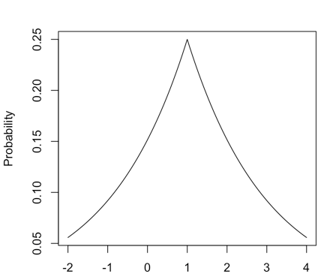
What is randomized function?
Answer: 3
Randomized function
Answer: A = 2.1
A randomized function here is used to PERTURB the TRUE answer to a query by adding random noise generated by a distribution:
Instead of answering 3, we may get the answer 2.1
Notes:
Instead of answering the true result 1, the mechanism will give a random response like 1.8 generated by a distribution. For instance, there is 25% probability to answer 1. The probability of answering 0 is near 15%

Slide 37
What is randomized function?
Answer: 3
Randomized function
Answer: A = 2.1
A randomized function here is used to PERTURB the TRUE answer to a query by adding random noise generated by a distribution:
Instead of answering 3, we may get the answer 2.1
A distribution describes the probability of any random answer.
Notes:
Instead of answering the true result 1, the mechanism will give a random response like 1.8 generated by a distribution. For instance, there is 25% probability to answer 1. The probability of answering 0 is near 15%

Slide 38
What is randomized function?
Answer: 3
Randomized function
Answer: A = 2.1
Pr[K(D)=3]=0.24
A randomized function here is used to PERTURB the TRUE answer to a query by adding random noise generated by a distribution:
Instead of answering 3, we may get the answer 2.1
Distribution describes the probability we get an random answer. For instance, here the probability of getting answer 3 is 0.24, denoted Pr[K(D)=3]=0.24 (K is a randomized function and D represents a dataset).
Notes:
Instead of answering the true result 1, the mechanism will give a random response like 1.8 generated by a distribution. For instance, there is 25% probability to answer 1. The probability of answering 0 is near 15%

Slide 39
What is randomized function?
Answer: 3
Randomized function
Answer: A = 2.1
Pr[K(D)=3]=0.24
A randomized function here is used to PERTURB the TRUE answer to a query by adding random noise generated by a distribution:
Instead of answering 3, we may get the answer 2.1
Distribution describes the probability we get an random answer. For instance, here the probability of getting answer 3 is 0.24, denoted Pr[K(D)=3]=0.24 (K is a randomized function and D represents a dataset).
This means if we ask the query 100 TIMES, we probably get answer equals 3 approximately 24 TIMES
Notes:
Instead of answering the true result 1, the mechanism will give a random response like 1.8 generated by a distribution. For instance, there is 25% probability to answer 1. The probability of answering 0 is near 15%

Slide 40
Let’s try it!
Answer: 3
Randomized function
SAMPLE 100 TIMES
Notes:
Instead of answering the true result 1, the mechanism will give a random response like 1.8 generated by a distribution. For instance, there is 25% probability to answer 1. The probability of answering 0 is near 15%

Slide 41
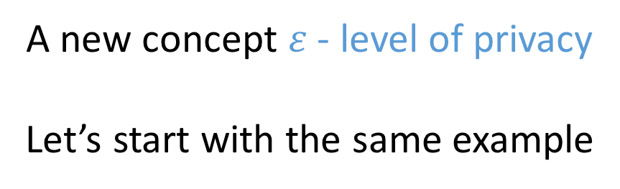
Differential privacy is trying to MASK DIFFERENCE of the same query to the neighboring datasets
A new concept $ε$ - level of privacy
Let’s start with the same example

Slide 42
Differential privacy is trying to MASK DIFFERENCE of the same query to the neighboring datasets
How many people have HIV
How many people have HIV
ADVERSARY
Dataset D2
Dataset D1
D1 and D2 are neighboring datasets
Answer: 3
Randomized function
Answer: 2
Answer: A
$$≈$$
Answer: B

Slide 43
Differential privacy is trying to MASK DIFFERENCE of the same query to the neighboring datasets
How many people have HIV
How many people have HIV
ADVERSARY
Dataset D2
Dataset D1
D1 and D2 are neighboring datasets
Answer: 3
Randomized function
Answer: 2
Answer: A
$$≈$$
How similar do you want?
Answer: B

Slide 44
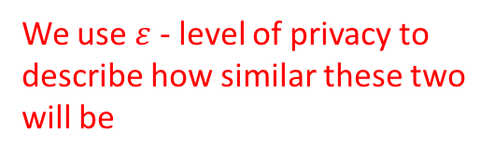
Differential privacy is trying to MASK DIFFERENCE of the same query to the neighboring datasets
How many people have HIV
How many people have HIV
ADVERSARY
Dataset D2
Dataset D1
D1 and D2 are neighboring datasets
Answer: 3
Randomized function
Answer: 2
Answer: A
We use $ε$ - level of privacy to describe how similar these two will be
$$≈$$
Answer: B

Slide 45

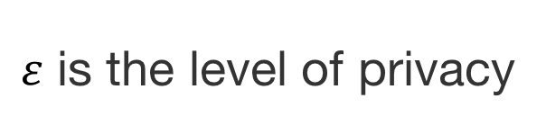
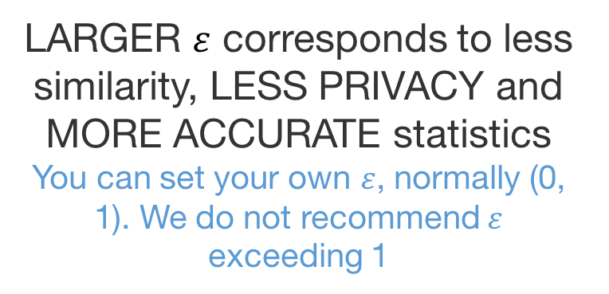
$ε$ is the level of privacy
LARGER $ε$ corresponds to less similarity, LESS PRIVACY and MORE ACCURATE statistics
You can set your own $ε$, normally (0, 1). We do not recommend $ε$ exceeding 1
Notes:
Instead of answering the true result 1, the mechanism will give a random response like 1.8 generated by a distribution. For instance, there is 25% probability to answer 1. The probability of answering 0 is near 15%

Slide 46
Now you’re ready to learn the definition of differential privacy
Notes:
Instead of answering the true result 1, the mechanism will give a random response like 1.8 generated by a distribution. For instance, there is 25% probability to answer 1. The probability of answering 0 is near 15%

Slide 47
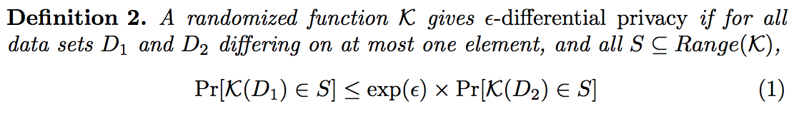

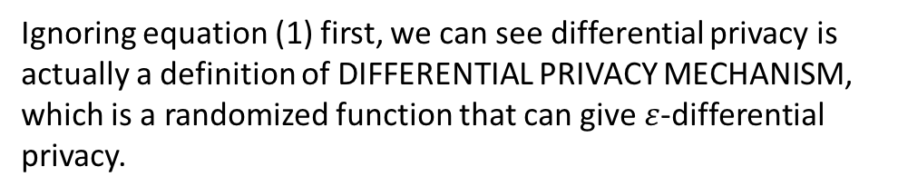
Ignoring equation (1) first, we can see differential privacy is actually a definition of DIFFERENTIAL PRIVACY MECHANISM, which is a randomized function that can give $ε$-differential privacy.
Notes:
Instead of answering the true result 1, the mechanism will give a random response like 1.8 generated by a distribution. For instance, there is 25% probability to answer 1. The probability of answering 0 is near 15%

Slide 48
Ignoring equation (1) first, we can see differential privacy is actually a definition of DIFFERENTIAL PRIVACY MECHANISM, which is a randomized function that can give $ε$-differential privacy.
What kind of randomized function can give us $ε$-differential privacy?
Notes:
Instead of answering the true result 1, the mechanism will give a random response like 1.8 generated by a distribution. For instance, there is 25% probability to answer 1. The probability of answering 0 is near 15%

Slide 49
What kind of randomized function can give us $ε$-differential privacy?
Let’s again, go back to the previous example
Notes:
Instead of answering the true result 1, the mechanism will give a random response like 1.8 generated by a distribution. For instance, there is 25% probability to answer 1. The probability of answering 0 is near 15%

Slide 50


What kind of randomized function can give us $ε$-differential privacy?
How many people have HIV
How many people have HIV
ADVERSARY
Dataset D2
Dataset D1
D1 and D2 are neighboring datasets
Answer: 3
Randomized function
Answer: 2
Answer: A
We use $ε$ - level of privacy to describe how similar these two will be
$$≈$$
Answer: B
Notes:
Instead of answering the true result 1, the mechanism will give a random response like 1.8 generated by a distribution. For instance, there is 25% probability to answer 1. The probability of answering 0 is near 15%

Slide 51
What kind of randomized function can give us $ε$-differential privacy?
How many people have HIV
How many people have HIV
ADVERSARY
Dataset D2
Dataset D1
D1 and D2 are neighboring datasets
Answer: 3
Randomized function
Answer: 2
Answer: A
We use $ε$ - level of privacy to describe how similar these two will be
$$≈$$
Answer: B
HOW?
Notes:
Instead of answering the true result 1, the mechanism will give a random response like 1.8 generated by a distribution. For instance, there is 25% probability to answer 1. The probability of answering 0 is near 15%

Slide 52
What kind of randomized function can give us $ε$-differential privacy?
How many people have HIV
How many people have HIV
ADVERSARY
Dataset D2
Dataset D1
D1 and D2 are neighboring datasets
Answer: 3
Randomized function
Answer: 2
Answer: A
We use $ε$ - level of privacy to describe how similar these two will be
$$≈$$
Answer: B
HOW?
Using equation (1)
Notes:
Instead of answering the true result 1, the mechanism will give a random response like 1.8 generated by a distribution. For instance, there is 25% probability to answer 1. The probability of answering 0 is near 15%

Slide 53
Recall that randomized function give us a distribution to add random noise to the true answer to a query
True answer
Randomized function
Answer: A
All possible responses
Range(M)
Notes:
Instead of answering the true result 1, the mechanism will give a random response like 1.8 generated by a distribution. For instance, there is 25% probability to answer 1. The probability of answering 0 is near 15%

Slide 54
Here we have two queries (although they’re the same) to the two neighboring datasets D1 and D2
Notes:
Instead of answering the true result 1, the mechanism will give a random response like 1.8 generated by a distribution. For instance, there is 25% probability to answer 1. The probability of answering 0 is near 15%

Slide 55

Here we have two queries (although they’re the same) to the two neighboring datasets D1 and D2
How many people have HIV
How many people have HIV
ADVERSARY
Dataset D2
Dataset D1
D1 and D2 are neighboring datasets
Answer: 3
Randomized function
Answer: 2
Answer: A
$$≈$$
Answer: B
Notes:
Instead of answering the true result 1, the mechanism will give a random response like 1.8 generated by a distribution. For instance, there is 25% probability to answer 1. The probability of answering 0 is near 15%

Slide 56
Then the randomized function will give us TWO DISTRIBUTIONS to the TWO QUERIES
Notes:
Instead of answering the true result 1, the mechanism will give a random response like 1.8 generated by a distribution. For instance, there is 25% probability to answer 1. The probability of answering 0 is near 15%

Slide 57
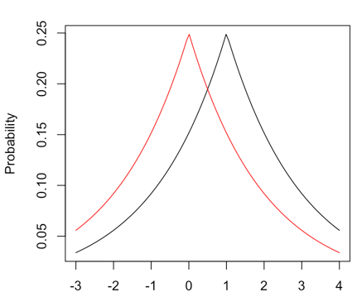
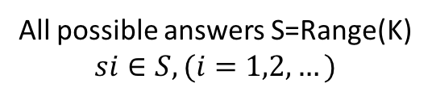
Then the randomized function will give us TWO DISTRIBUTIONS to the TWO QUERIES
True result
B’
A’
s1
s2
s3
s4
……
All possible answers S=Range(K)
$$si∈S, (i=1,2,…)$$
S is the group of all possible output of the randomized function K.
Notes:
Instead of answering the true result 1, the mechanism will give a random response like 1.8 generated by a distribution. For instance, there is 25% probability to answer 1. The probability of answering 0 is near 15%

Slide 58
Then the randomized function will give us TWO DISTRIBUTIONS to the TWO QUERIES
True result
B’
A’
Two randomized answers A and B generated by these two distributions, respectively
Answer B
Answer A
s1
s2
s3
s4
……
All possible answers S=Range(K)
$$si∈S, (i=1,2,…)$$
S is the group of all possible output of the randomized function K.
Notes:
Instead of answering the true result 1, the mechanism will give a random response like 1.8 generated by a distribution. For instance, there is 25% probability to answer 1. The probability of answering 0 is near 15%

Slide 59
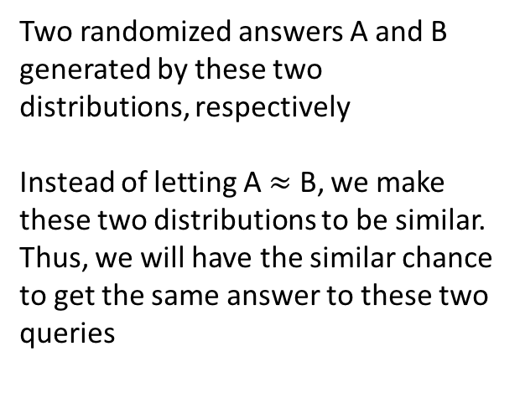
Then the randomized function will give us TWO DISTRIBUTIONS to the TWO QUERIES
True result
B’
A’
Two randomized answers A and B generated by these two distributions, respectively
Instead of letting A $≈$ B, we make these two distributions to be similar.
Thus, we will have the similar chance to get the same answer to these two queries
Answer B
Answer A
s1
s2
s3
s4
……
All possible answers S=Range(K)
$$si∈S, (i=1,2,…)$$
S is the group of all possible output of the randomized function K.
Notes:
Instead of answering the true result 1, the mechanism will give a random response like 1.8 generated by a distribution. For instance, there is 25% probability to answer 1. The probability of answering 0 is near 15%

Slide 60
Recall the definition of differential privacy
Notes:
Instead of answering the true result 1, the mechanism will give a random response like 1.8 generated by a distribution. For instance, there is 25% probability to answer 1. The probability of answering 0 is near 15%

Slide 61
Notes:
Instead of answering the true result 1, the mechanism will give a random response like 1.8 generated by a distribution. For instance, there is 25% probability to answer 1. The probability of answering 0 is near 15%

Slide 62
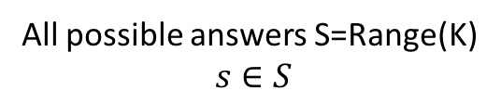
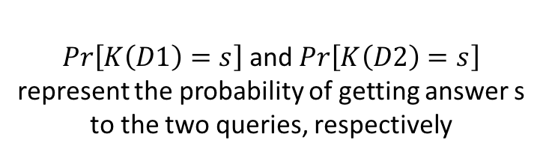
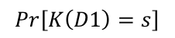
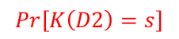
True result
$Pr\left[K\left(D1\right)=s\right]$ and $Pr\left[K\left(D2\right)=s\right]$ represent the probability of getting answer s to the two queries, respectively
$$Pr\left[K\left(D2\right)=s\right]$$
$$Pr\left[K\left(D1\right)=s\right]$$
s
All possible answers S=Range(K)
$s∈S$
Notes:
Instead of answering the true result 1, the mechanism will give a random response like 1.8 generated by a distribution. For instance, there is 25% probability to answer 1. The probability of answering 0 is near 15%

Slide 63
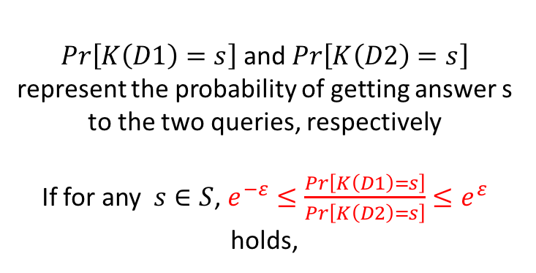
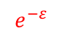
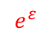
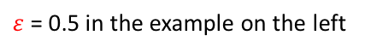
True result
$Pr\left[K\left(D1\right)=s\right]$ and $Pr\left[K\left(D2\right)=s\right]$ represent the probability of getting answer s to the two queries, respectively
If for any $s∈S$, $e^{−ε}≤\frac{Pr\left[K\left(D1\right)=s\right]}{Pr\left[K\left(D2\right)=s\right]}≤e^{ε}$ holds,
$$Pr\left[K\left(D2\right)=s\right]$$
$$Pr\left[K\left(D1\right)=s\right]$$
$$e^{−ε}$$
1
$$e^{ε}$$
$ε$ = 0.5 in the example on the left
s
All possible answers S=Range(K)
$s∈S$
Notes:
Instead of answering the true result 1, the mechanism will give a random response like 1.8 generated by a distribution. For instance, there is 25% probability to answer 1. The probability of answering 0 is near 15%

Slide 64
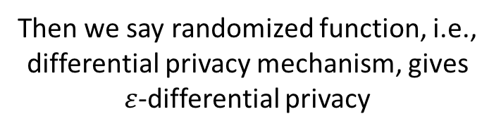
True result
$Pr\left[K\left(D1\right)=s\right]$ and $Pr\left[K\left(D2\right)=s\right]$ represent the probability of getting answer s to the two queries, respectively
If for any $s∈S$, $e^{−ε}≤\frac{Pr\left[K\left(D1\right)=s\right]}{Pr\left[K\left(D2\right)=s\right]}≤e^{ε}$ holds,
$$Pr\left[K\left(D2\right)=s\right]$$
$$Pr\left[K\left(D1\right)=s\right]$$
$$e^{−ε}$$
1
$$e^{ε}$$
$ε$ = 0.5 in the example on the left
s
All possible answers S=Range(K)
$s∈S$
Then we say randomized function, i.e., differential privacy mechanism, gives $ε$-differential privacy
Notes:
Instead of answering the true result 1, the mechanism will give a random response like 1.8 generated by a distribution. For instance, there is 25% probability to answer 1. The probability of answering 0 is near 15%

Slide 65
Differential privacy is a statistical property of mechanism behavior, a definition, not an algorithm.
Notes:
Instead of answering the true result 1, the mechanism will give a random response like 1.8 generated by a distribution. For instance, there is 25% probability to answer 1. The probability of answering 0 is near 15%

Slide 66

WHY?

Slide 67
WHY?
In Netflix Prize dataset, not two records are similar more than 50%.
If the profile can be matched up to 50% similarity to a profile in IMDb , then the adversary knows with good chance the true identity of the profile

Slide 68
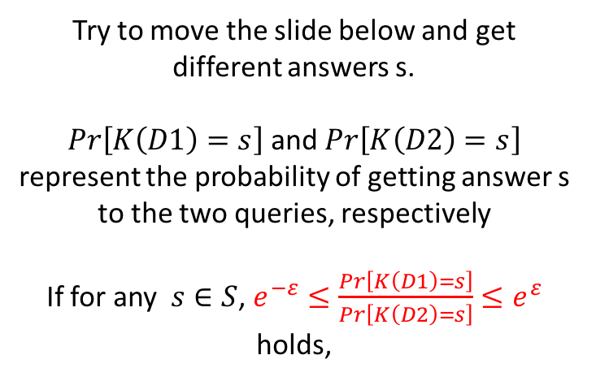
True result
Try to move the slide below and get different answers s.
$Pr\left[K\left(D1\right)=s\right]$ and $Pr\left[K\left(D2\right)=s\right]$ represent the probability of getting answer s to the two queries, respectively
If for any $s∈S$, $e^{−ε}≤\frac{Pr\left[K\left(D1\right)=s\right]}{Pr\left[K\left(D2\right)=s\right]}≤e^{ε}$ holds,
$$Pr\left[K\left(D2\right)=s\right]$$
$$Pr\left[K\left(D1\right)=s\right]$$
s
All possible answers S=Range(K)
$s∈S$
Notes:
Instead of answering the true result 1, the mechanism will give a random response like 1.8 generated by a distribution. For instance, there is 25% probability to answer 1. The probability of answering 0 is near 15%

Slide 69
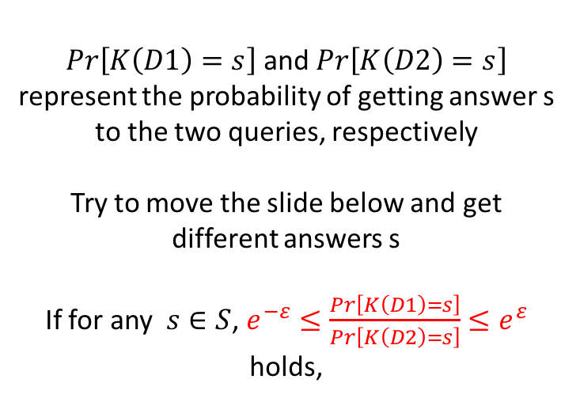
True result
$Pr\left[K\left(D1\right)=s\right]$ and $Pr\left[K\left(D2\right)=s\right]$ represent the probability of getting answer s to the two queries, respectively
Try to move the slide below and get different answers s
If for any $s∈S$, $e^{−ε}≤\frac{Pr\left[K\left(D1\right)=s\right]}{Pr\left[K\left(D2\right)=s\right]}≤e^{ε}$ holds,
$$Pr\left[K\left(D2\right)=s\right]$$
$$Pr\left[K\left(D1\right)=s\right]$$
s
All possible answers S=Range(K)
$s∈S$
Notes:
Instead of answering the true result 1, the mechanism will give a random response like 1.8 generated by a distribution. For instance, there is 25% probability to answer 1. The probability of answering 0 is near 15%

Slide 70
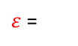
True result
$Pr\left[K\left(D1\right)=s\right]$ and $Pr\left[K\left(D2\right)=s\right]$ represent the probability of getting answer s to the two queries, respectively
If for any $s∈S$, $e^{−ε}≤\frac{Pr\left[K\left(D1\right)=s\right]}{Pr\left[K\left(D2\right)=s\right]}≤e^{ε}$ holds,
$$Pr\left[K\left(D2\right)=s\right]$$
$$Pr\left[K\left(D1\right)=s\right]$$
$$e^{−ε}$$
1
$$e^{ε}$$
$ε$ =
0
1
s
All possible answers S=Range(K)
$s∈S$
Notes:
Instead of answering the true result 1, the mechanism will give a random response like 1.8 generated by a distribution. For instance, there is 25% probability to answer 1. The probability of answering 0 is near 15%

Slide 71
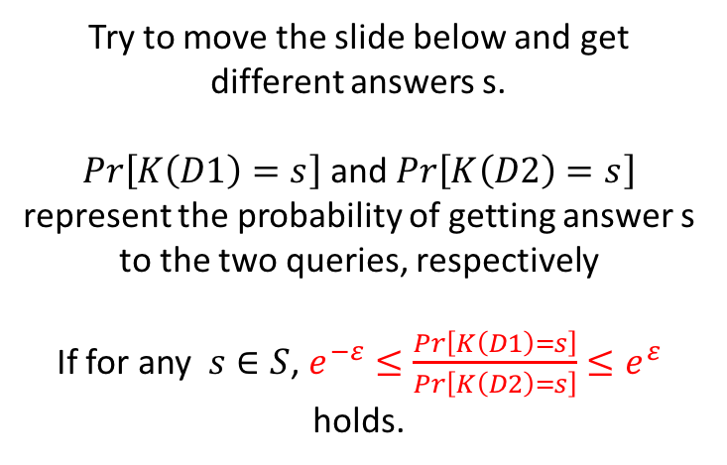
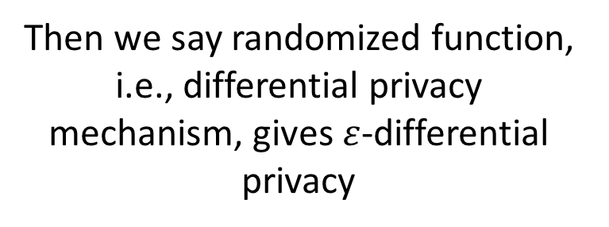
True result
Try to move the slide below and get different answers s.
$Pr\left[K\left(D1\right)=s\right]$ and $Pr\left[K\left(D2\right)=s\right]$ represent the probability of getting answer s to the two queries, respectively
If for any $s∈S$, $e^{−ε}≤\frac{Pr\left[K\left(D1\right)=s\right]}{Pr\left[K\left(D2\right)=s\right]}≤e^{ε}$ holds.
Pr[K(D2)]
Pr[K(D1)]
$$Pr\left[K\left(D2\right)=s\right]$$
$$Pr\left[K\left(D1\right)=s\right]$$
Then we say randomized function, i.e., differential privacy mechanism, gives $ε$-differential privacy
s
All possible answers S=Range(K)
$s∈S$
Notes:
Instead of answering the true result 1, the mechanism will give a random response like 1.8 generated by a distribution. For instance, there is 25% probability to answer 1. The probability of answering 0 is near 15%

Slide 72
True result
Try to move the slide below and get different answers s.
$Pr\left[K\left(D1\right)=s\right]$ and $Pr\left[K\left(D2\right)=s\right]$ represent the probability of getting answer s to the two queries, respectively
If for any $s∈S$, $e^{−ε}≤\frac{Pr\left[K\left(D1\right)=s\right]}{Pr\left[K\left(D2\right)=s\right]}≤e^{ε}$ holds.
Pr[K(D2)]
Pr[K(D1)]
$$Pr\left[K\left(D2\right)=s\right]$$
$$Pr\left[K\left(D1\right)=s\right]$$
Then we say randomized function, i.e., differential privacy mechanism, gives $ε$-differential privacy
s
All possible answers S=Range(K)
$s∈S$
Notes:
Instead of answering the true result 1, the mechanism will give a random response like 1.8 generated by a distribution. For instance, there is 25% probability to answer 1. The probability of answering 0 is near 15%

Slide 73
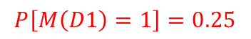
What is randomized function?
Answer: 3
Randomized function
Hover over the distribution function M (curve), you will see the probability of getting different answer A. For instance,
Answer: A = 2.1
A randomized function here is used to PERTURB the TRUE answer to a query by adding random noise generated by a distribution
$$P\left[M\left(D1\right)=1\right]=0.25$$
which means if you sample 100 times, you will get answer A = 1 about 25 times.
All possible responses
Range(M)
SAMPLE
SAMPLE 100
(Try SAMPLE to get different Answer A)
Notes:
Instead of answering the true result 1, the mechanism will give a random response like 1.8 generated by a distribution. For instance, there is 25% probability to answer 1. The probability of answering 0 is near 15%

Slide 74
What is randomized function?
Answer: 3
Randomized function
Hover over the distribution function M (curve), you will see the probability of getting different answer A. For instance,
Answer: A = 2.1
A randomized function here is used to PERTURB the TRUE answer to a query by adding random noise generated by a distribution
$$P\left[M\left(D1\right)=1\right]=0.25$$
which means if you sample 100 times, you will get answer A = 1 about 25 times.
All possible responses
Range(M)
SAMPLE
SAMPLE 100
(Try SAMPLE to get different Answer A)
Notes:
Instead of answering the true result 1, the mechanism will give a random response like 1.8 generated by a distribution. For instance, there is 25% probability to answer 1. The probability of answering 0 is near 15%

Slide 75
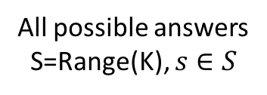
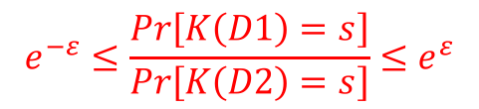
True result
Try to move the slide below and get different answers, equation (1) describes that for any possible answer you get,
Pr[K(D2)]
Pr[K(D1)]
$$e^{−ε}≤\frac{Pr\left[K\left(D1\right)=s\right]}{Pr\left[K\left(D2\right)=s\right]}≤e^{ε}$$
holds
$$Pr\left[K\left(D2\right)=s\right]$$
$$Pr\left[K\left(D1\right)=s\right]$$
Then we say randomized function, i.e., differential privacy mechanism, gives $ε$-differential privacy
s
All possible answers
S=Range(K), $s∈S$
Notes:
Instead of answering the true result 1, the mechanism will give a random response like 1.8 generated by a distribution. For instance, there is 25% probability to answer 1. The probability of answering 0 is near 15%

Slide 76
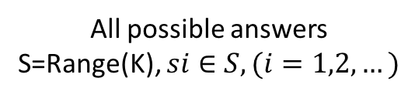
Then the randomized function will give us TWO DISTRIBUTIONS to the TWO QUERIES
True result
Neighboring datasets
B’
A’
Query
Database with you D1
True result A’
Randomized function K
Pr[K(D2)]
Pr[K(D1)]
Query
Database without you D2
True result B'
Randomized function K
s1
s2
s3
s4
……
S is the group of all possible output of the randomized function K.
All possible answers
S=Range(K), $si∈S, (i=1,2,…)$
Notes:
Instead of answering the true result 1, the mechanism will give a random response like 1.8 generated by a distribution. For instance, there is 25% probability to answer 1. The probability of answering 0 is near 15%

Slide 77
Then the randomized function will give us TWO DISTRIBUTIONS to the TWO QUERIES
We want these two distributions Pr[K(D1)] and Pr[K(D2)] to be similar
True result
Neighboring datasets
B’
A’
Query
Database with you D1
True result A’
Randomized function K
Pr[K(D2)]
Pr[K(D1)]
Query
Database without you D2
True result B'
Randomized function K
s1
s2
s3
s4
……
S is the group of all possible output of the randomized function K.
All possible answers
S=Range(K), $si∈S, (i=1,2,…)$
Notes:
Instead of answering the true result 1, the mechanism will give a random response like 1.8 generated by a distribution. For instance, there is 25% probability to answer 1. The probability of answering 0 is near 15%

Slide 78
A randomized function here is used to perturb the true answer to a query by adding random noise generated by a distribution
query
Database D
result A
Randomized function
response B
Notes:
Instead of answering the true result 1, the mechanism will give a random response like 1.8 generated by a distribution. For instance, there is 25% probability to answer 1. The probability of answering 0 is near 15%

Slide 79
A randomized function here is used to perturb the true answer to a query by adding random noise generated by a distribution
query
Database with you D1
result A
Mechanism M
response B
Result A
Response B
For instance result A = 1
Result A
All possible responses
Range(M)
Notes:
Instead of answering the true result 1, the mechanism will give a random response like 1.8 generated by a distribution. For instance, there is 25% probability to answer 1. The probability of answering 0 is near 15%

Slide 80
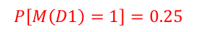
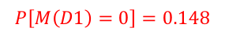
The probability of getting response 1 is about 0.25 and the probability of answering 0 is near 0.15, which means if you sample 100 times, about 25 times you will get answer 1, about 15 times you will get answer 0.
Result A
$$P\left[M\left(D1\right)=1\right]=0.25$$
$$P\left[M\left(D1\right)=0\right]=0.148$$
All possible responses
Range(M)
Sample
Notes:
Instead of answering the true result 1, the mechanism will give a random response like 1.8 generated by a distribution. For instance, there is 25% probability to answer 1. The probability of answering 0 is near 15%

Slide 81
Differential privacy is trying to MASK DIFFERENCE of the same query to the neighboring datasets
How many people have HIV
How many people have HIV
YOU
Dataset D2
Dataset D1
D1 and D2 are neighboring datasets
Answer: A
If we don’t answer the true result 3 and 2
Answer: B

Slide 82
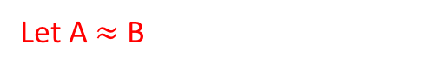
Differential privacy is trying to MASK DIFFERENCE of the same query to the neighboring datasets
How many people have HIV
How many people have HIV
YOU
Dataset D2
Dataset D1
D1 and D2 are neighboring datasets
Answer: A
$$≈$$
Answer: B
Let A $≈$ B

Slide 83
Differential privacy is trying to MASK DIFFERENCE of the same query to the neighboring datasets
How many people have HIV
How many people have HIV
YOU
Dataset D2
Dataset D1
D1 and D2 are neighboring datasets
Answer: A
$$≈$$
This promises individuals that the similar result will be learnt even if you’re not in the dataset
Answer: B

Slide 84
Differential privacy is trying to MASK DIFFERENCE of the same query to the neighboring datasets
How many people have HIV
How many people have HIV
YOU
Dataset D2
Dataset D1
D1 and D2 are neighboring datasets
Answer: 3
Randomized function
Answer: 2
Answer: A
$$≈$$
Going through a randomized function
Answer: B

